Slide 1
Algorithms and Complexities DisAlg: abstractions
刘盛云

Slide 2
Uptime and downtime with SLA
Service-Level Agreement (SLA)
99.9%
Daily: 1m 26s
Weekly: 10m 4.8s
Monthly: 43m 28s
Yearly: 8h 41m 38s
99.99%
Daily: 8.6s
Weekly: 1m 0.48s
Monthly: 4m 21s
Yearly: 52m 9.8s

Slide 3
Outline
This course
Distributed Computation
Abstracting Failures
Abstracting Communication
Timing Assumptions
Abstracting time

Slide 4
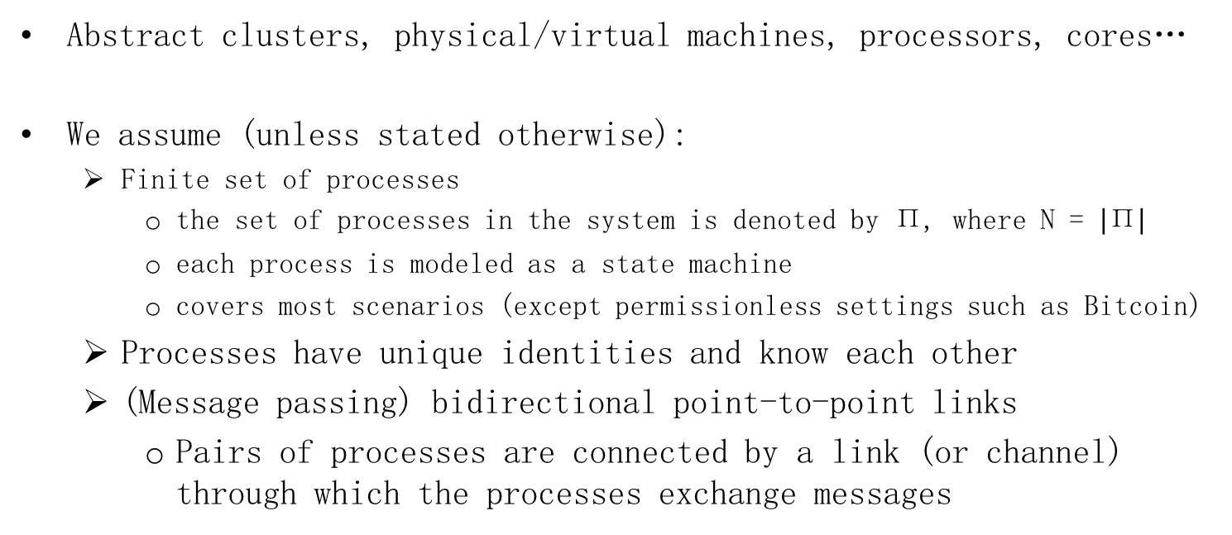
Processes
Abstract clusters, physical/virtual machines, processors, cores…
We assume (unless stated otherwise):
Finite set of processes
the set of processes in the system is denoted by Π, where N = $\left|\text{Π}\right|$
each process is modeled as a state machine
covers most scenarios (except permissionless settings such as Bitcoin)
Processes have unique identities and know each other
(Message passing) bidirectional point-to-point links
Pairs of processes are connected by a link (or channel) through which the processes exchange messages

Slide 5
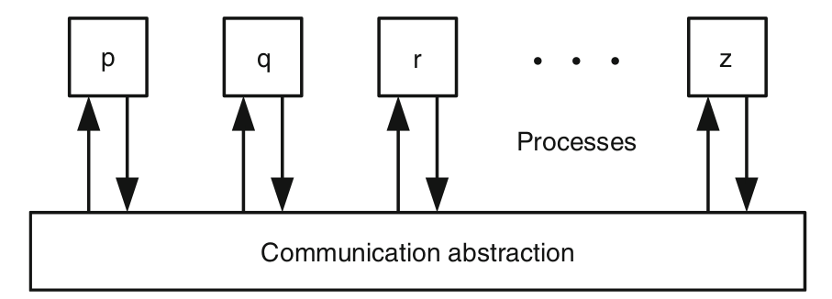
Processes and communication

Slide 6
Local steps
Process p_{i} computation proceeds in steps
Step:
1) Send event: put a message in outbuf_{i}[j], for every neighbor p_{j}
2) Receive event: get messages m from inbuf_{i}[*]
3) Computation event: Perform local computation → Change state
Local state changes from current state S to new state S’ as S’= f(S,m)
O₁
O₂
O₃
m₁
m₂
m₃
S₁
S₂
S₃
S₄

Slide 7
Message passing
Inbuf_{i}[j]
Holds messages sent by p_{j} delivered to (but not processed by) p_{i}
Outbuf_{i}[j]
Holds messages sent by p_{i} not delivered to p_{j}
Message m sent by p_{i} to p_{j}:
1) First in Outbuf_{i}[j]
2) Upon delivery, in Inbuf_{j}[i]

Slide 8


Executions and configurations
The execution of a distributed algorithm is represented by a sequence of steps executed by the processes.
Configuration C is a vector of individual process states
C = (S¹, S², … S^{n})
The execution captures the evolution of the global state
C₀, s₁, C₁, s₂, C₂….
Where s_{k} is a step taken by some process
A configuration is a global state
Not accessible to processes!
We need it for reasoning about algorithms

Slide 9
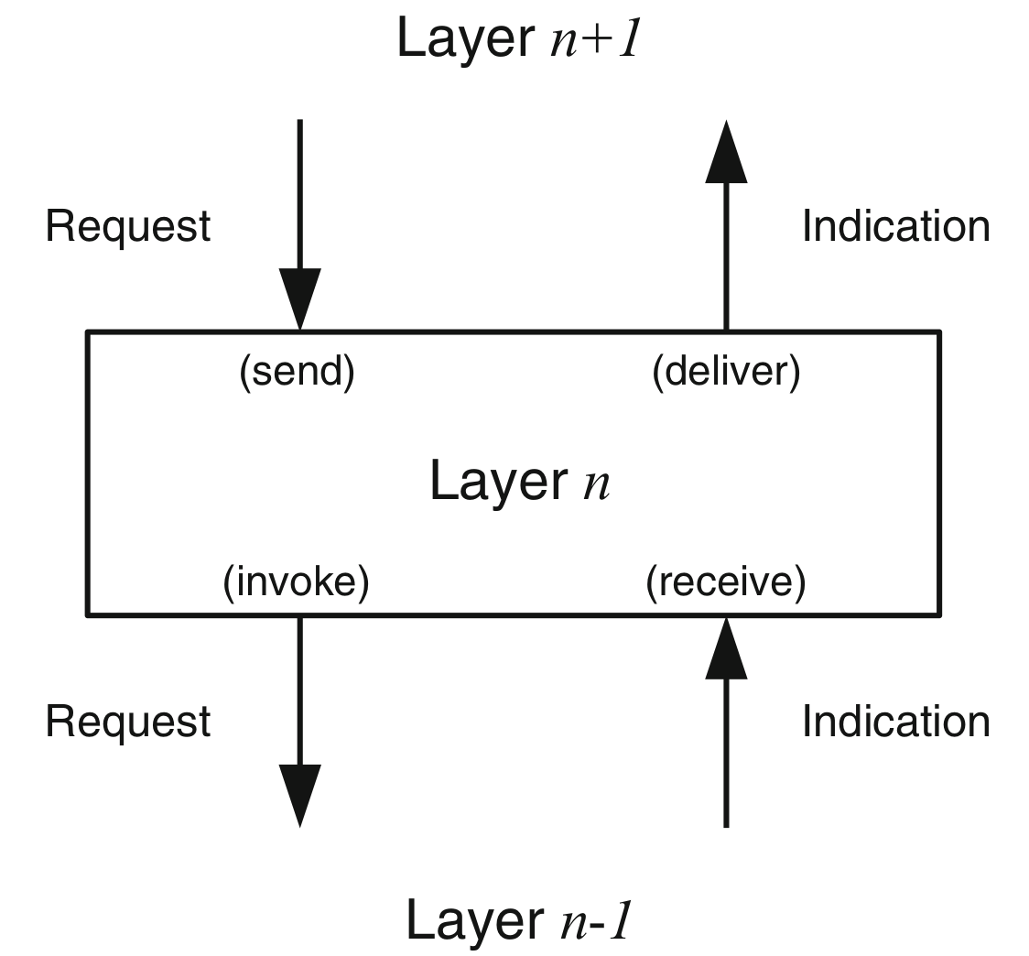
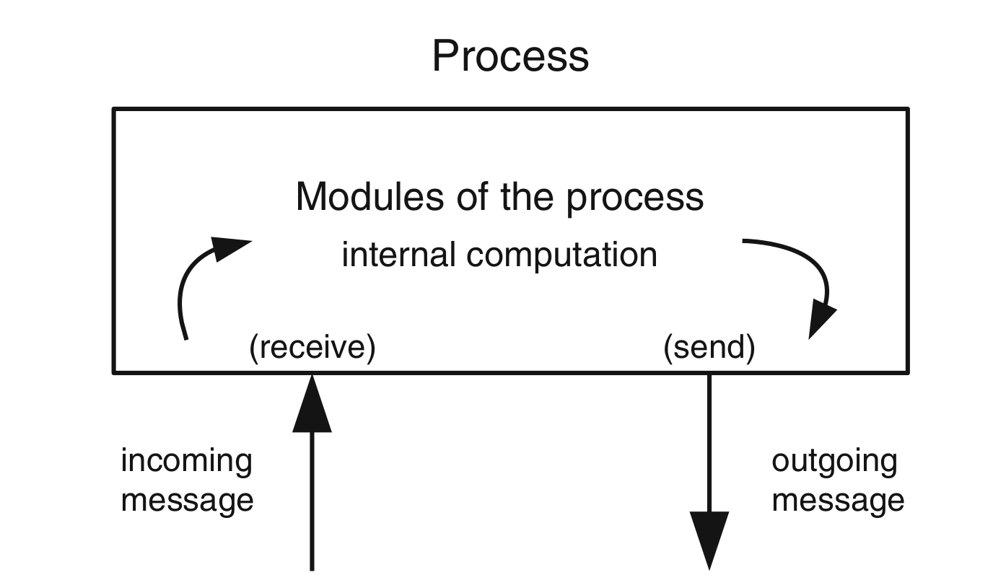
Step of a process and layering

Slide 10
JobHandler specification
Name: JobHandler, instance jh.
Request: < jh, Submit | job >: Requests a job to be processed.
Indication: < jh, Confirm | job >: Confirms that the given job has been (or will be) processed.
Indication: think of it as a callback function
Properties:
JH1. Guaranteed response: Every submitted job is eventually confirmed.

Slide 11
Algorithm: Synchronous JobHandler
Implements: JobHandler, instance jh.
Get familiar with the event-driven style
upon event < jh, Submit | job > do
process(job);
trigger < jh, Confirm | job >;

Slide 12
Algorithm: Asynchronous JobHandler
Implements: JobHandler, instance jh.
upon event < jh, Init > do
buffer := ∅;
upon event < jh, Submit | job > do
buffer := buffer ∪ {job};
trigger < jh, Confirm | job >;
upon buffer ≠ ∅ do
job := selectjob(buffer);
process(job);
buffer := buffer \ {job};

Slide 13
Outline
This course
Distributed Computation
Abstracting Failures
Abstracting Communication
Timing Assumptions
Abstracting time

Slide 14
Process failures
A failure occurs when a process does not behave according to the algorithm
A process that does not fail is called correct
Faulty processes:
Crash (crash-stop)
Process stops execution of the algorithm: crashes
Process may crash in the middle of a step
Notably, of a send event
Crash-recovery
Process might temporarily crash, but then recover its state and proceed taking steps
Process may crash and recover for an infinite number of times

Slide 15
Process failures (cont’d)
Omission
The process omits to send/receive messages it is supposed to send/receive
Due to, e.g., buffer overflows or network congestion
Byzantine
Unrestricted, arbitrary
Malicious behavior allowed, models intrusions, bugs, etc.
Special case: Authenticated Byzantine fault
Faulty process cannot subvert cryptographic primitives (e.g., digital signatures)

Slide 16
Process failures hierarchy
Crash
Crash-recovery
Omission
Byzantine

Slide 17
Outline
This course
Distributed Computation
Abstracting Failures
Abstracting Communication
Timing Assumptions
Abstracting time

Slide 18
Link failures
It is possible for messages to be lost
Due to, e.g., best-effort delivery at the Internet layer
But, the probability for a message to reach its destination is nonzero
Keep on retransmitting messages until they reach their destinations
At a higher layer, end-to-end argument

Slide 19
Fair-loss links
Name: FairLossPointToPointLinks, instance fll.
Request: < fll, Send | q, m >: Requests to send message m to process q.
Indication: < fll, Deliver | p, m >: Delivers message m sent by process p.
Properties:
FLL1. Fair-loss: If a correct process p infinitely often sends a message m to a correct process q, then q delivers m an infinite number of times.
FLL2. Finite duplication: If a correct process p sends a message m a finite number of times to process q, then m cannot be delivered an infinite number of times by q.
FLL3. No creation: If some process q delivers a message m with sender p, then m was previously sent to q by process p.
Correspond to UDP

Slide 20
Stubborn links
Name: StubbornPointToPointLinks, instance sl.
Request: < sl, Send | q, m >: Requests to send message m to process q.
Indication: < sl, Deliver | p, m >: Delivers message m sent by process p.
Properties:
SL1. Stubborn delivery: If a correct process p sends a message m once to a correct process q, then q delivers m an infinite number of times.
SL2. No creation: If some process q delivers a message m with sender p, then m was previously sent to q by process p.
I.e., retransmission mechanism

Slide 21
Algorithm: Retransmit Forever
Implements: StubbornLink (sl).
Uses: FairLossLink (fll).
upon event < sl, Init > do
sent := ∅;
starttimer(Δ);
upon event < Timeout > do
forall (q, m) ∈ sent do
trigger < fll, Send | q, m >;
starttimer(Δ);
upon event < sl, Send | q, m > do
trigger < fll, Send | q, m >;
sent := sent ∪ {(q, m)};
upon event < fll, Deliver | p, m > do
trigger < sl, Deliver | p, m >;

Slide 22
Perfect (Reliable) links
Name: PerfectPointToPointLinks, instance pl.
Request: < pl, Send | q, m >: Requests to send message m to process q.
Indication: < pl, Deliver | p, m >: Delivers message m sent by process p.
Properties:
PL1. Reliable delivery: If a correct process p sends a message m to a correct process q, then q eventually delivers m.
PL2. No duplication: No message is delivered by a process more than once.
PL3. No creation: If some process q delivers a message m with sender p, then m was previously sent to q by process p.
Correspond to TCP

Slide 23
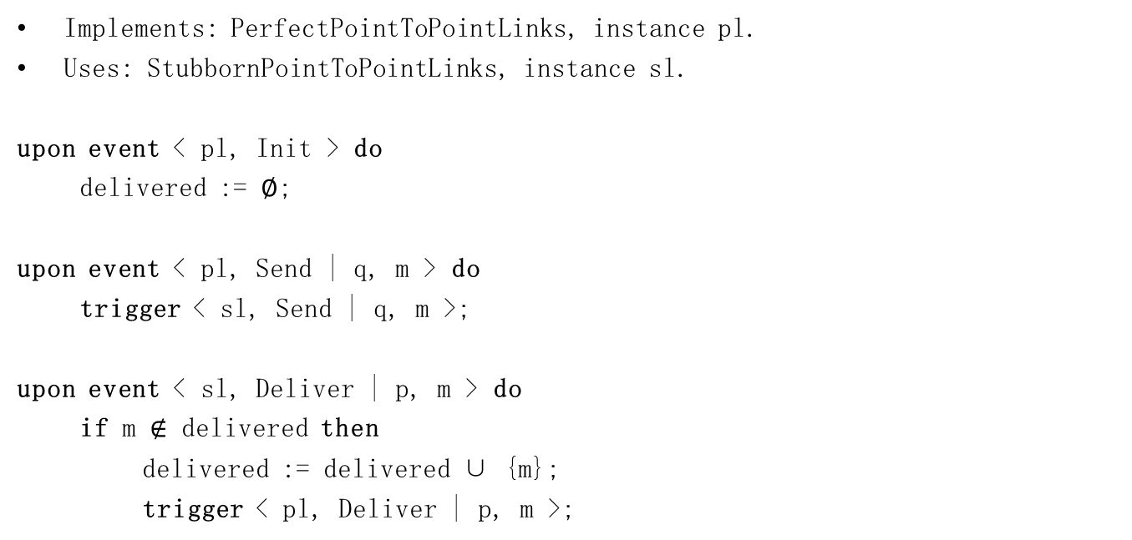
Algorithm: Eliminate Duplicates
Implements: PerfectPointToPointLinks, instance pl.
Uses: StubbornPointToPointLinks, instance sl.
upon event < pl, Init > do
delivered := ∅;
upon event < pl, Send | q, m > do
trigger < sl, Send | q, m >;
upon event < sl, Deliver | p, m > do
if m $∉$ delivered then
delivered := delivered ∪ {m};
trigger < pl, Deliver | p, m >;

Slide 24
In this course
Asynchronous message passing:
Perfect links + Fully connected network
Unless stated otherwise
Perfect links
Roughly, guarantee that a message sent between two correct processes will not be lost
i.e., eventual delivery is guaranteed
NB: Perfect links ≠ FIFO

Slide 25
Outline
This course
Distributed Computation
Abstracting Failures
Abstracting Communication
Timing Assumptions
Abstracting time

Slide 26
Timing assumptions
Whether or not we can make any assumption about time bounds on
communication delays
process speeds
clock drifts

Slide 27
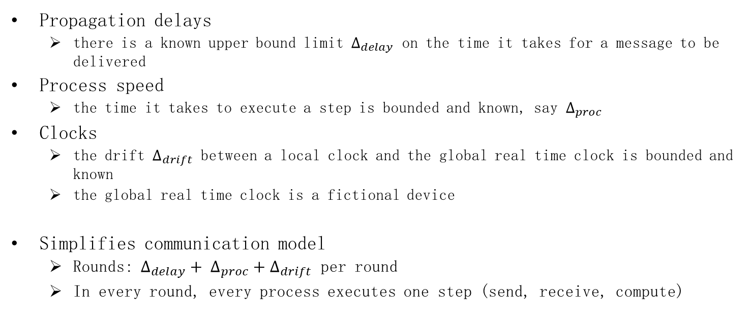
Synchronous message passing
Propagation delays
there is a known upper bound limit $∆_{delay}$ on the time it takes for a message to be delivered
Process speed
the time it takes to execute a step is bounded and known, say $∆_{proc}$
Clocks
the drift $∆_{drift}$ between a local clock and the global real time clock is bounded and known
the global real time clock is a fictional device
Simplifies communication model
Rounds： $∆_{delay}+ ∆_{proc}+∆_{drift}$ per round
In every round, every process executes one step (send, receive, compute)

Slide 28


Synchronous message passing
$$∆_{delay}+ ∆_{proc}+∆_{drift}$$
p1
p2
p3
Block₀
10 mins
Block₁
10 mins
Block₂
10 mins
Block₃
…
not quite feasible until Bitcoin was created

Slide 29
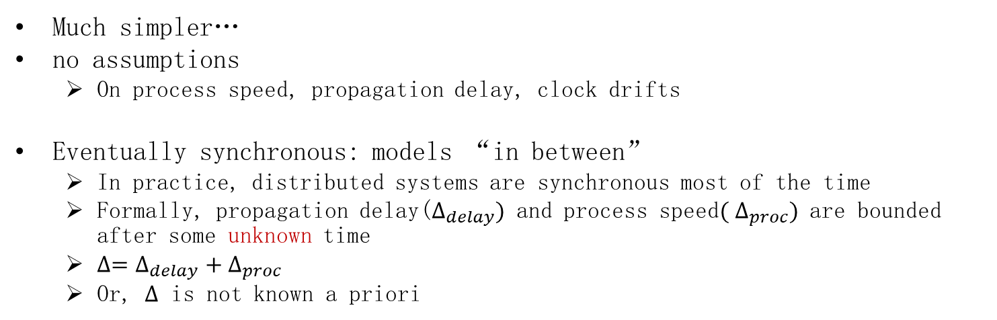
Asynchronous message passing
Much simpler…
no assumptions
On process speed, propagation delay, clock drifts
Eventually synchronous: models “in between”
In practice, distributed systems are synchronous most of the time
Formally, propagation delay($∆_{delay})$ and process speed$( ∆_{proc})$ are bounded after some unknown time
${∆=∆}_{delay}+∆_{proc}$
Or, $∆$ is not known a priori
asynchrony
synchrony
asynchrony
synchrony
time

Slide 30
Outline
This course
Distributed Computation
Abstracting Failures
Abstracting Communication
Timing Assumptions
Abstracting time

Slide 31
Failure detectors
When a process in a distributed system
fails (say crashes)
how can we tell?
Synchonous vs asynchronous model?

Slide 32




Asynchronous message passing
detecting a process failure (with the help of timing assumptions) is unreliable!
heartbeat message
A
network fault？
B
process fault?
after 2∆ time

Slide 33
Failure detectors (FDs)
Provide processes with information about crashed processes
Implemented using (or encapsulating) timing assumptions
Depending on the timing assumptions, the output of a FD can be accurate or not
FDs often give “hints” about failures rather than reliable information
Unreliable FDs

Slide 34
Failure detectors
Indication: < P, Crash | p >: Detects that process p has crashed.
Properties:
Completeness
Accuracy

Slide 35
Failure detectors
Perfect (P)
Strong Completeness: Eventually, every process that crashes is permanently suspected by every correct process
Strong Accuracy: No process is suspected before it crashes
Eventually Perfect (◊P)
Strong Completeness
Eventual Strong Accuracy: Eventually, no correct process is ever suspected

Slide 36
Perfect failure detector
Name: PerfectFailureDetector, instance P.
Indication: < P, Crash | p >: Detects that process p has crashed.
Properties:
PFD1. Strong completeness: Eventually, every process that crashes is permanently detected by every correct process.
PFD2. Strong accuracy: If a process p is detected by any process, then p has crashed.

Slide 37
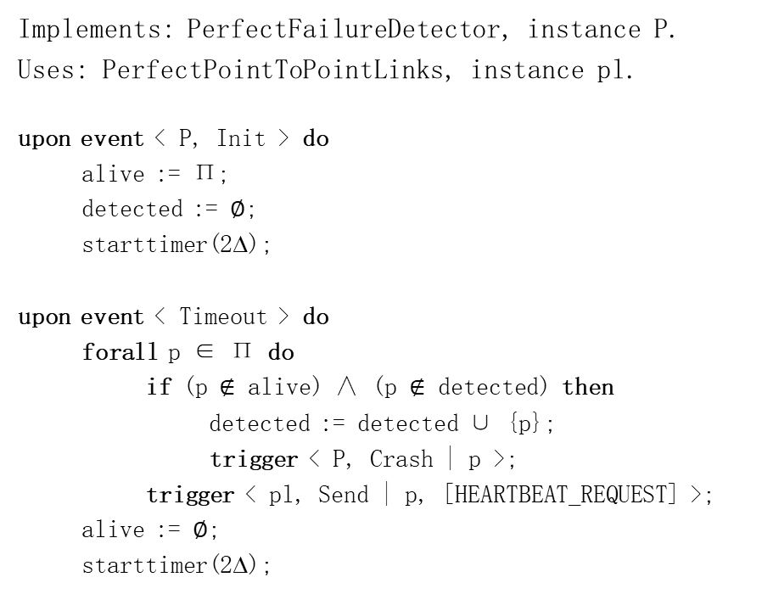
Algorithm: Exclude on Timeout
Implements: PerfectFailureDetector, instance P.
Uses: PerfectPointToPointLinks, instance pl.
upon event < P, Init > do
alive := Π;
detected := ∅;
starttimer(2∆);
upon event < Timeout > do
forall p ∈ Π do
if (p $∉$ alive) ∧ (p $∉$ detected) then
detected := detected ∪ {p};
trigger < P, Crash | p >;
trigger < pl, Send | p, [HEARTBEAT_REQUEST] >;
alive := ∅;
starttimer(2∆);
upon event < pl, Deliver | q, [HEARTBEAT_REQUEST] > do
trigger < pl, Send | q, [HEARTBEAT_REPLY] >;
upon event < pl, Deliver | p, [HEARTBEAT_REPLY] > do
alive := alive ∪ {p};

Slide 38
Example
2Δ
2Δ
p1
p2
p3
heartbeat_
request
heartbeat_
reply
heartbeat_
request
heartbeat_
reply
alive = {p1,p2,p3}
detected = {}
alive = {p1,p3}
detected = {p2}

Slide 39
Homework-1
What happens if the assumption for Δ does not hold? Which property is violated? Give an example.

Slide 40
Eventually perfect failure detector
Name: EventuallyPerfectFailureDetector, instance ◇P.
Indication: < ◇P, Suspect | p >: Notifies that process p is suspected to have crashed.
Indication: < ◇P, Restore | p >: Notifies that process p is not suspected anymore.
Properties:
EPFD1. Strong completeness: Eventually, every process that crashes is permanently suspected by every correct process.
EPFD2. Eventual strong accuracy: Eventually, no correct process is suspected by any correct process.

Slide 41
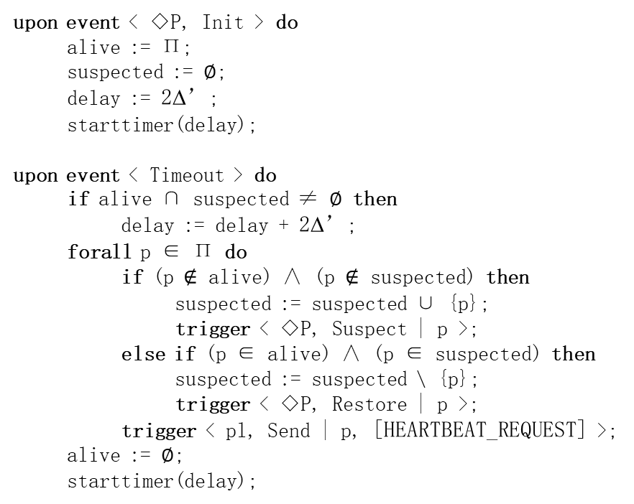
Algorithm: Increasing Timeout
Implements: EventuallyPerfectFailureDetector, instance ◇P.
Uses: PerfectPointToPointLinks, instance pl.
upon event < ◇P, Init > do
alive := Π;
suspected := ∅;
delay := 2∆’;
starttimer(delay);
upon event < Timeout > do
if alive ∩ suspected ≠ ∅ then
delay := delay + 2∆’;
forall p ∈ Π do
if (p $∉$ alive) ∧ (p $∉$ suspected) then
suspected := suspected ∪ {p};
trigger < ◇P, Suspect | p >;
else if (p ∈ alive) ∧ (p ∈ suspected) then
suspected := suspected \ {p};
trigger < ◇P, Restore | p >;
trigger < pl, Send | p, [HEARTBEAT_REQUEST] >;
alive := ∅;
starttimer(delay);
upon event < pl, Deliver | q, [HEARTBEAT_REQUEST] > do
trigger < pl, Send | q, [HEARTBEAT_REPLY] >;
upon event < pl, Deliver | p, [HEARTBEAT_REPLY] > do
alive := alive ∪ {p};
∆ is not known a priori!
Eventually, delay > 2∆

Slide 42
Example
2Δ’
2Δ’
4Δ’
p1
p2
p3
heartbeat_
request
heartbeat_
reply
heartbeat_
request
heartbeat_
reply
alive = {p1,p3}
suspected = {p2}
alive = {p1,p2,p3}
suspected = {}
p1,p3:
alive = {p1,p2,p3}
suspected = {}
p2:

Slide 43
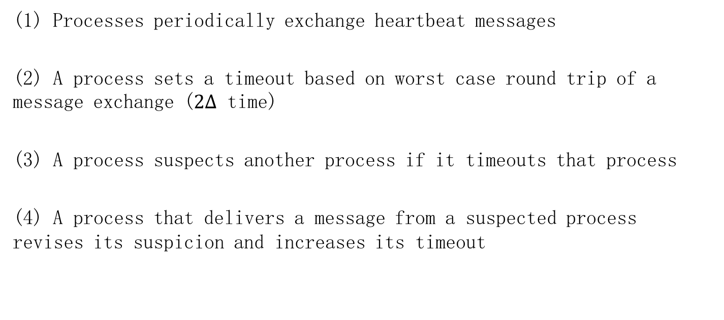
Generic FD implementation (sketch)
(1) Processes periodically exchange heartbeat messages
(2) A process sets a timeout based on worst case round trip of a message exchange ($2∆$ time)
(3) A process suspects another process if it timeouts that process
(4) A process that delivers a message from a suspected process revises its suspicion and increases its timeout

Slide 44
Leader Election
Identifies one process that has not failed
Each process eventually elects itself as the leader or a follower, such that there is exactly one leader
Why elect a leader?
Synchronization/coordination tasks become much simpler
We can use the leader to “centralize” the algorithm
Data processing, Resource allocation, Scheduling
Coordinating consensus
Why not?
Stability?: Leader fails → must reelect one
Bottleneck

Slide 45
Leader election specification
Name: LeaderElection, instance le.
Indication: < le, Leader | p >: indicates that process p is elected as leader.
Properties:
LE1. Eventual detection: either there is no correct process, or some correct process is eventually elected as the leader.
LE2. Accuracy: If a process is leader, then all previously elected leaders have crashed.

Slide 46
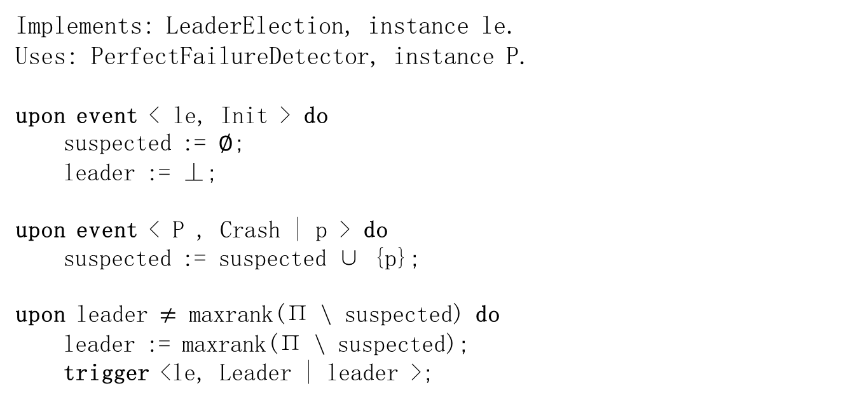
Algorithm: Monarchical Leader Election
Implements: LeaderElection, instance le.
Uses: PerfectFailureDetector, instance P.
upon event < le, Init > do
suspected := ∅;
leader := ⊥;
upon event < P , Crash | p > do
suspected := suspected ∪ {p};
upon leader $≠$ maxrank(Π \ suspected) do
leader := maxrank(Π \ suspected);
trigger <le, Leader | leader >;

Slide 47
Example
2Δ
2Δ
p1
p2
p3
heartbeat_
request
heartbeat_
reply
heartbeat_
request
heartbeat_
reply
leader = p1
leader = p1
leader = p2
suspected={p1}

Slide 48
Eventual leader detector
Name: EventualLeaderDetector, instance Ω.
Indication: < Ω, Trust | p >: Indicates that process p is trusted to be leader.
Properties:
ELD1. Eventual accuracy: There is a time after which every correct process trusts some correct process.
ELD2. Eventual agreement: There is a time after which no two correct processes trust different correct processes.

Slide 49
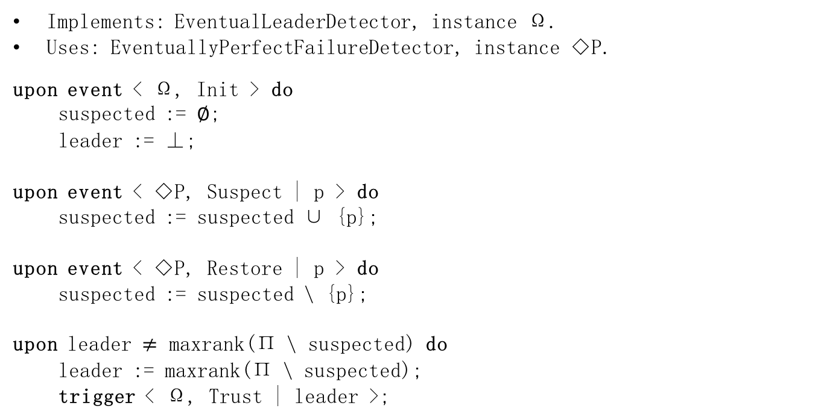
Algorithm: Monarchical Eventual Leader Detection
Implements: EventualLeaderDetector, instance Ω.
Uses: EventuallyPerfectFailureDetector, instance ◇P.
upon event < Ω, Init > do
suspected := ∅;
leader := ⊥;
upon event < ◇P, Suspect | p > do
suspected := suspected ∪ {p};
upon event < ◇P, Restore | p > do
suspected := suspected \ {p};
upon leader $≠$ maxrank(Π \ suspected) do
leader := maxrank(Π \ suspected);
trigger < Ω, Trust | leader >;

Slide 50
Example
2Δ’
2Δ’
4Δ’
p1
p2
p3
heartbeat_
request
heartbeat_
reply
heartbeat_
request
heartbeat_
reply
leader = p1
p1,p3:
leader = p1
leader = p1
p2:
leader = p2
suspected={p1}

Slide 51
Homework-2
If we would prefer p2 to be the leader (though it may crash), give an eventual leader detection algorithm that additionally ensures
If p2 does not crash, then eventually p2 is elected as the leader by every correct process.

